Slide 1
Notes:
Introducing PHEMI Research

Slide 2
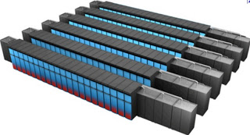
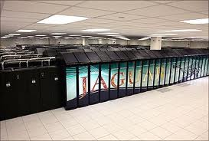
Cray

Slide 3
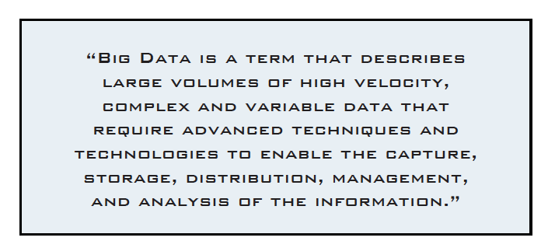
BigData Definition

Slide 4
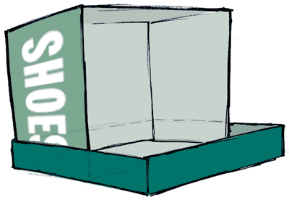

BigData
Big Data is a ‘ShoeBox’ of everything
Notes:
There’s an enormous and fundamental shift in healthcare today. A shift from Document Management to Data Mining for the purposes of continuous improvement.
Spearheaded by the US “Health Information Technology for Economic and Clinical Health Act” (HITECH). Broken down into three stages of Meaningful Use.
Drive to data mining for continuous improvement in productivity and patient outcomes.
Stage 1: Data capture and sharing
Stage 2: Advance clinical processes
Stage 3: Improved outcomes

Slide 5
Big Data
We store an immense volume, variety and velocity of data
Why …
Compute is cheap and storage is free

Slide 6
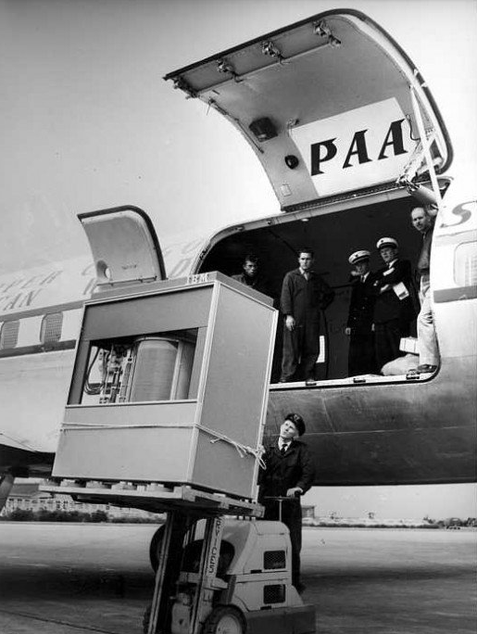
“Big Data” is a relative term!
This is what a 5MB hard drive looked like in 1956! (note: required a forklift).
http://goo.gl/f1PkV

Slide 7
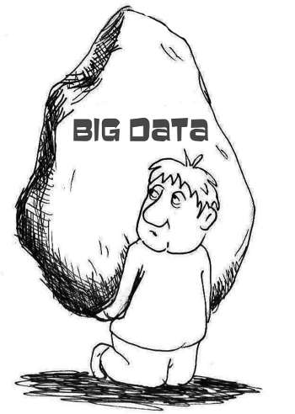
BigData
We rely on ‘Computing’ to extract the facts, relationships indicators and pointers.
We can now store and analyse (continually)
more data than humans can read in their lifetime!

Slide 8

BigData
BigData is an immense Strategic Asset
“Digital Government: Build a 21st Century Platform to Better Serve The American People.
Harnessing Big Data – White House Strategy 23rd May 2012

Slide 9
BigData Model
Compute/Analyze
Compute/Analyze
Data 1
Compute/Analyze
Compute/Analyze
Compute/Analyze
Collect/Store
Data 2
USE
…
Data n
Compute/Analyze
Compute/Analyze
Compute/Analyze
Compute/Analyze

Slide 10


Digital Library of Assets
Notes:
At the heart of it, PHEMI Central is a Digital Asset Library. Like a library with different types of books, videos, CDs, and magazines, they all have different rules about who can check out information; who can view information and where it’s located in the library. When a new Digital Asset is added to the library, it is catalogued. These rules and asset descriptions are called “metadata” and are wrapped around the data in PHEMI Central.

Slide 11

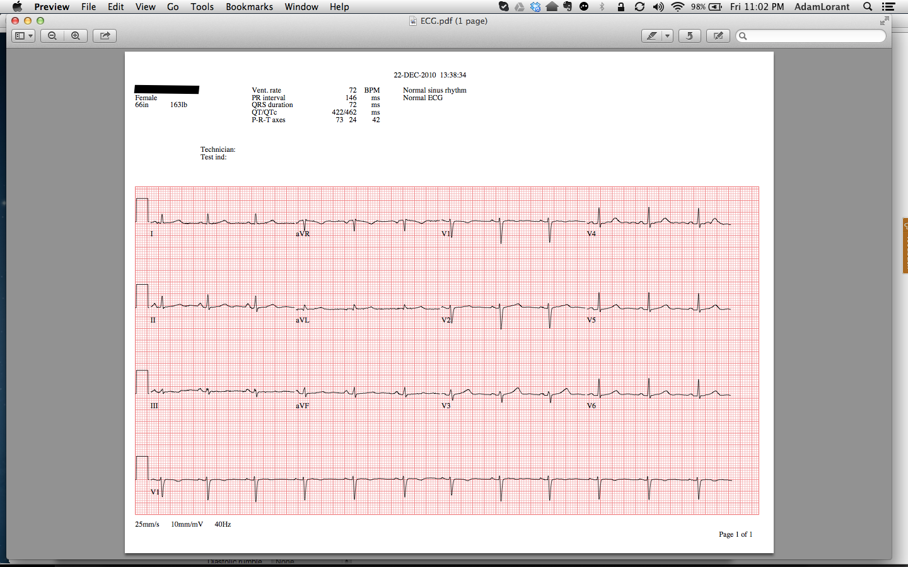
A Digital Asset
Digital Asset = Information + Metadata
Metadata
Timestamp of when it was imported
Location/Source imported from
Retention policy
Classification
Data type of asset
Version control information
Data agreements for the asset
Backup information
Etc.
Patient Information
Digital Asset
Notes:
A Digital Asset looks like this. It consists of the data itself (for example an ECG, lab result, X-Ray or Consult Letter) plus metadata which are rules and asset descriptions about the data. The metadata defines the Governance Model for a dataset. It’s the metadata that makes the digital asset valuable, and makes BIG Data for health care possible. Without it, it would be difficult to find the information we were looking for.

Slide 12
Security vs Privacy
Privacy discourse involves difficult normative decisions about competing claims to legitimate access to, use of, and alteration of information. It is about selecting among different philosophies, and choosing how various rights and entitlements ought to be ordered.
Security implements those choices – it intermediates between information and privacy selections.
Derek E. Bambauer: Privacy vs Security
University of Arizona - James E. Rogers College of Law
January 29, 2013

Slide 13
Privacy
Privacy is about :
Legitimate Claims to (Access - Use - Modify) Information
Legitimate Claim = f (Rights, Entitlements)
Hence: technical, business, legal, policy and Identity matter.
Note that Information != Data

Slide 14
Security
Security is not Privacy
When considering security think of:
A door lock, a burglar alarm and a tall fence. Think of guns, anti-counterfeiting measures on currency and that dumb liquid ban at airports.
Security affects privacy only when it's based on identity

Slide 15
Security / Privacy
Security is vital to survival
Privacy is a human (social) need (unique to humans)
Identity theft threatens security through a breach in privacy

Slide 16

PdB – Center of Excellence
Location: Ontario Canada

Slide 17
Gold Standard
Privacy by Design is fast becoming the ‘Gold Standard’ for Privacy, for example the US Federal Trade Commision has placed it at the center of its security and privacy protection.
We have a world where mobile, e-commerce, e-services, Machine2Machine and Cloud are the norm not the exception.

Slide 18
Enterprise Amnesia
Definition :
The inability of an organization to benefit from the information it has access to or has generated in the past.

Slide 19
7 Business Foundation Principles
Proactive not Reactive; Preventative not Remedial
Privacy as the Default Setting
Privacy Embedded into Design
Full Functionality – Positive Sum not Zero Sum
End to End Security – Full Lifecycle Protection
Visibility and Transparency – Keep it Open
Respect for User Privacy – Keep it User-Centric

Slide 20
Sense Making Systems
“Sensemaking” relates to an emerging class of technology designed to help organizations make better sense of their diverse observational space. This observation space will often encompass data they have in their possession and control (e.g., structured master data), as well as data they cannot control (e.g., externally-generated and less structured social media).
From a sensemaking point of view an organization can only be as smart as the sum of its observations.

Slide 21
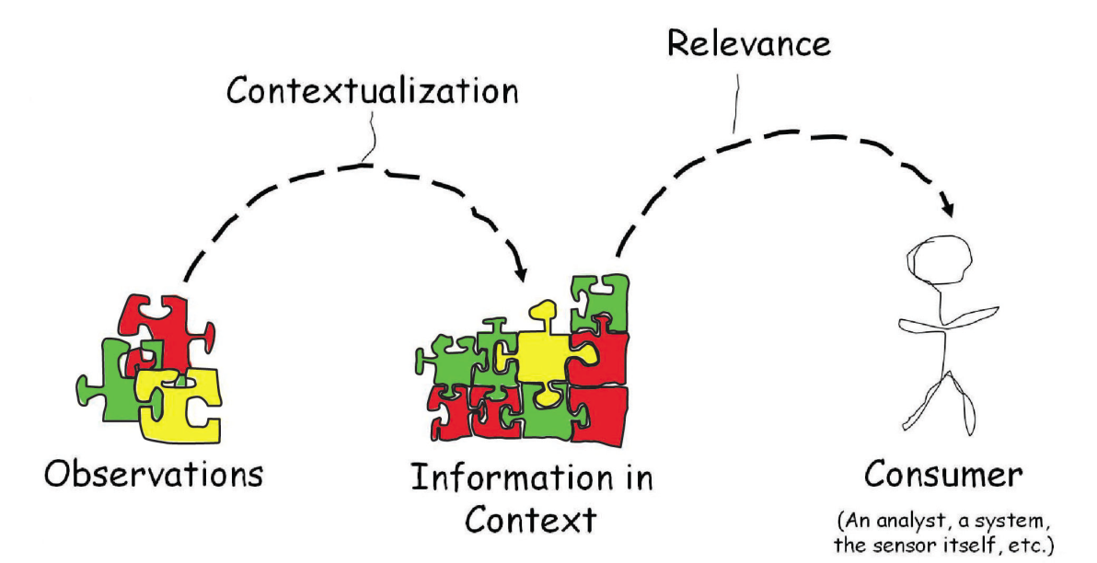
Sensemaking Systems
Context Accumulating Systems
Source: Privacy by Design in the Age of Big Data
Reduces false positives/negatives
Errors in the data are helpful – detects plausible variations
Integrating transactions becomes more accurate and (strangely) faster
Privacy/Security becomes harder as data/information becomes more valuable

Slide 22

Dr. Paul Terry President & CEO, PHEMI Health Systems
pterry@phemi.com

